Slide 1
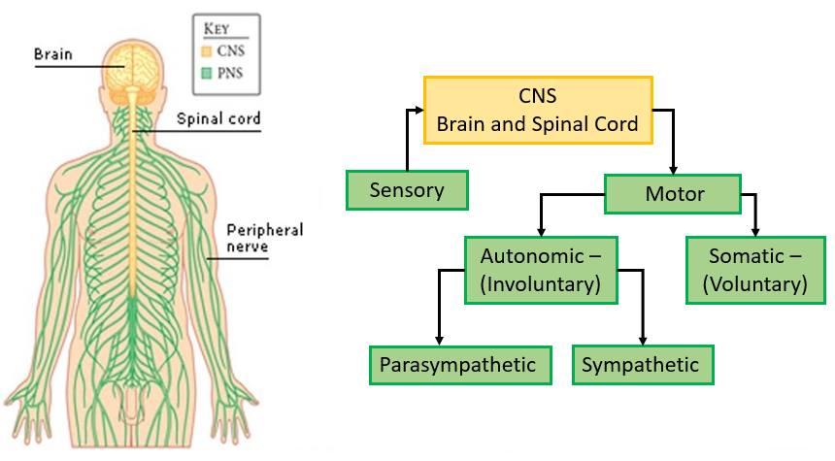
Divisions of the Nervous System - Overview Peripheral Nervous System (PNS) - Sensory
Ch4 HP: The nervous system is highly organised

Slide 2

Date: | Human Biology Year 12 ATAR
Do Now Complete the past exam question given, under test conditions (not for actual marks) Lesson Agenda 1: Do Now 2: Peripheral NS overview and PNS- Sensory 3: Work on Review Worksheet: PNS overview and sensory 4: Lesson summary and wind-up Suggested Study Compulsory: Complete review worksheet, mark and correct using answer key on Connect. Read through today’s notes and textbook section Write out the steps involved in transmission across the synapse. NEXT LESSON Past Exam Question PNS- Motor, Reflex Arcs | Learning Aims List the main parts of the Nervous System Describe how the PNS nerves connect with the CNS Describe the function of the PNS-Sensory Briefly describe how the sense organs receive information and pass it via the sensory PNS to the CNS Describe the receptors involved in touch and proprioception. List different sensors in the body, where they are located, and what they sense. Describe the organisation of sensory neurons and their pathway into the spinal cord.
 | Key Vocabulary Peripheral Nervous System (PNS) Central Nervous System (CNS) Sensory Receptors Proprioception Dorsal Ventral Ganglion

Slide 3
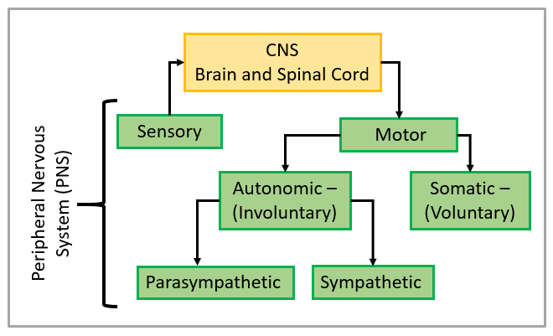
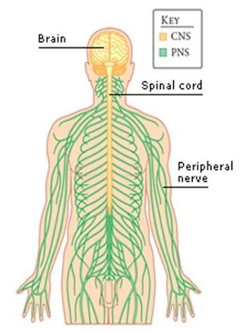
Overview
Nervous system consists of the brain, spinal cord, and all nerves.
Peripheral Nervous System (PNS) – we will focus on this now
Sensory and motor neurons, bundled into nerves
Take information to and from CNS
Clusters of nerve cell bodies (ganglia), outside of CNS
Central Nervous System (CNS ) – we will focus on this after PNS
brain and spinal cord
Learning Aim: List the main parts of the Nervous System

Slide 4
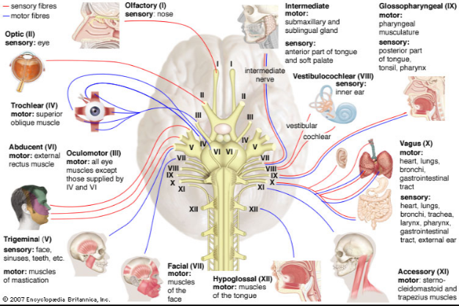
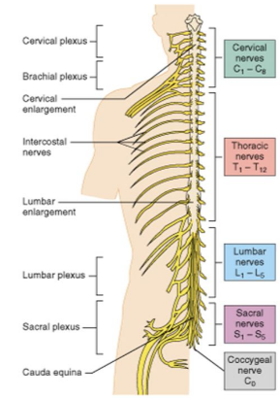
Nerves
Bundles of neurons
Can contain both sensory and motor neurons (mixed nerves)
Connect to brain /spinal cord
Transmit signals to and from CNS
Cranial Nerves (attached a base of brain):
12 cranial nerves
Some mixed nerves, others only sensory or only motor
Feed directly into brain base
Spinal Nerves (attach along spinal cord)
31 pairs of spinal nerves
All mixed nerves
Attach to spinal cord by 2 roots
Learning Aim: Describe how PNS nerves connect with the CNS

Slide 5
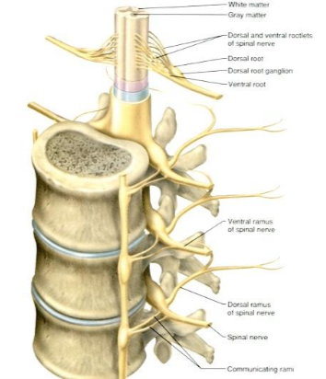
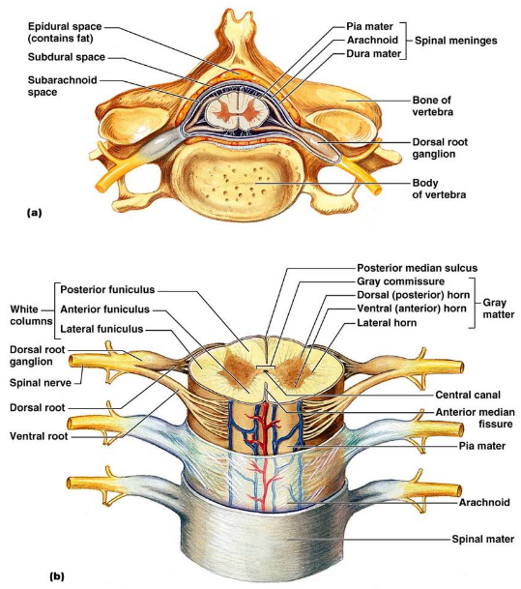
Spinal Nerve connection to Spinal Cord
Learning Aim: Describe how PNS nerves connect with the CNS

Slide 6
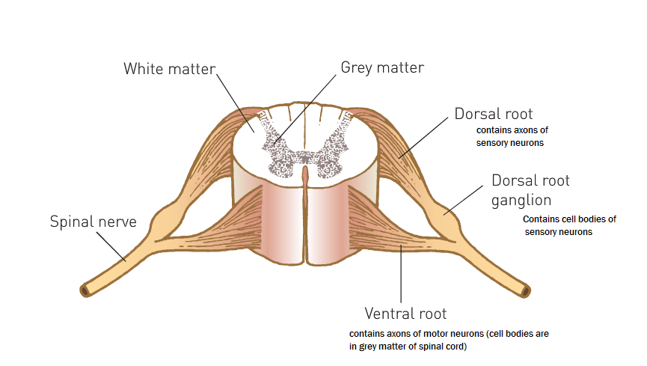
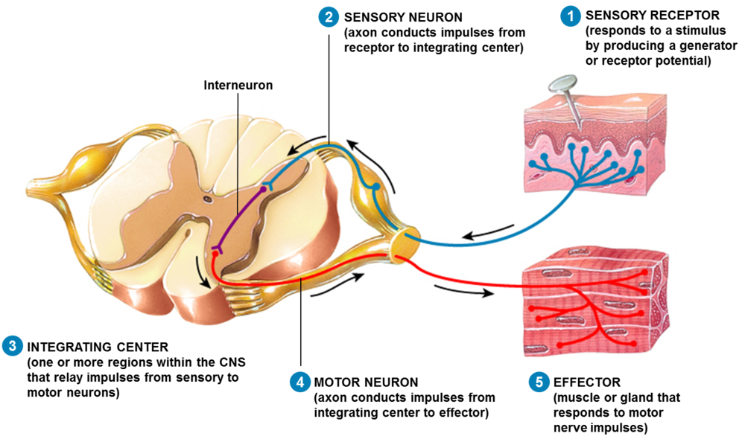
Spinal Nerve connection to Spinal Cord
Learning Aim: Describe how PNS nerves connect with the CNS

Slide 7
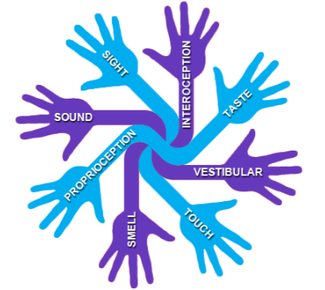
Peripheral Nervous System: Sensory (Afferent) Division
Ch4 HP: The nervous system is highly organised

Slide 8
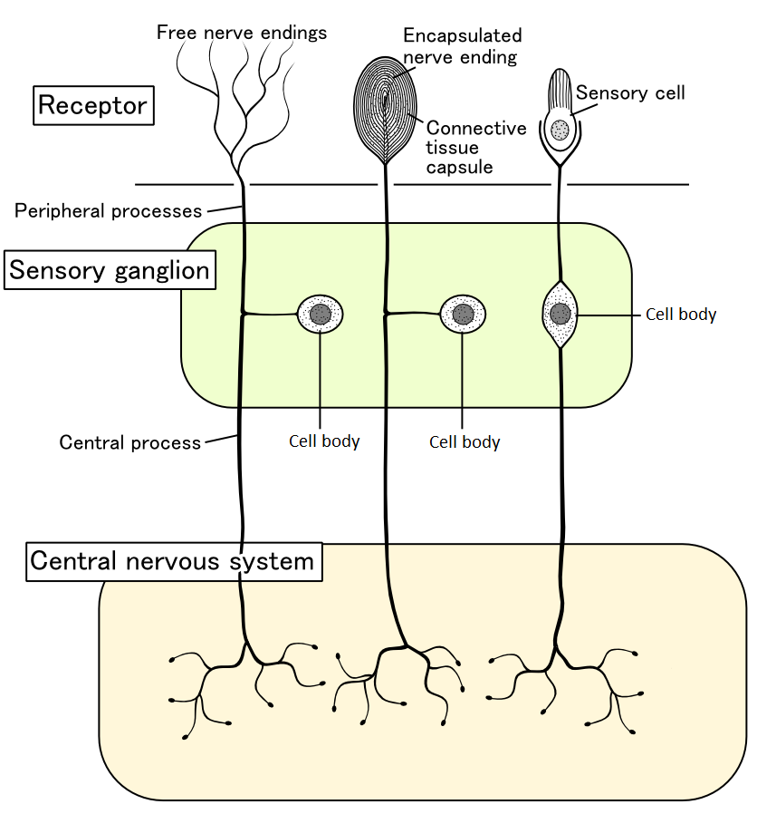
Senses and Receptors (PNS-Sensory)
Body receives signals at receptors/sensors.
Stimulated receptors send signals to sensory neurons.
Signals are passed to the CNS to be integrated and acted upon.
Learning Aim: Describe the function of the PNS Sensory

Slide 9
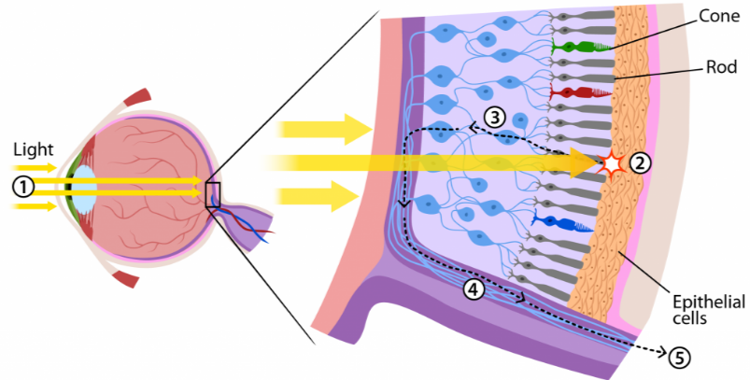
Sense organs (PNS-Sensory):
Eye:
Rod and cone cells in retina stimulated by light
Transmit signals via optic nerve to brain
Learning Aim: Briefly describe how the sense organs receive information and pass it via the sensory PNS to the CNS

Slide 10
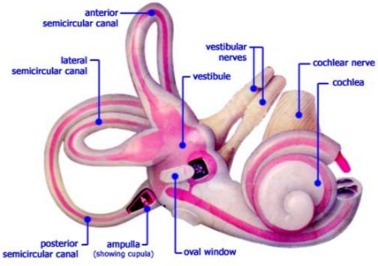
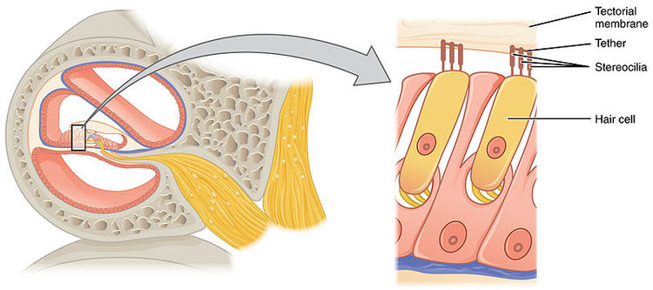
Sense Organs:
Ear:
Cochlea contains fluid and fine hair-like sensors that detect sound waves.
Transmit signals to brain via auditory nerve
Vestibular system series of canals and specialised sensory cells that detect position of head – balance.
Signals sent to brain via vestibular nerve
Learning Aim: Briefly describe how the sense organs receive information and pass it via the sensory PNS to the CNS

Slide 11
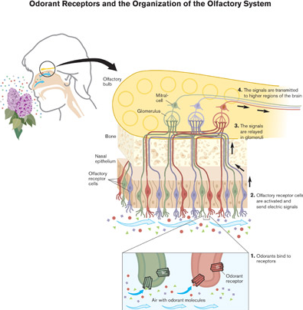
Sense Organs:
Nose (olfactory)
Specialised cells in nasal cavity send signals to brain via olfactory bulb and olfactory nerve.
Learning Aim: Briefly describe how the sense organs receive information and pass it via the sensory PNS to the CNS

Slide 12
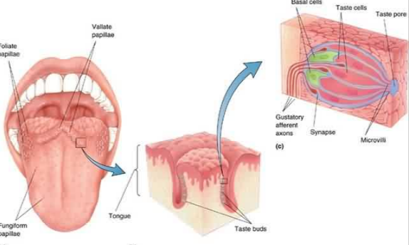
Sense Organs:
Taste
Specialised cells within epithelium of tongue send signals via facial nerve and other fibres
Learning Aim: Briefly describe how the sense organs receive information and pass it via the sensory PNS to the CNS

Slide 13
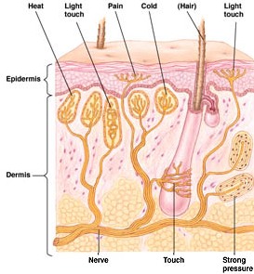
Senses and receptors
Touch
Specialised cells in the skin
Heat (thermoreceptors)
light pressure
pain
cold
strong pressure
Send signals via sensory nerves to the CNS
Learning Aim: Describe the receptors involved in touch

Slide 14
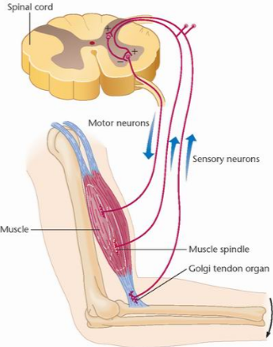
Senses and Receptors
Proprioception
Receptors located in muscles and joints provide information about body positioning
Learning Aim: Describe the receptors involved in proprioception

Slide 15

Types of receptors:
Thermoreceptors
Detect heat and cold
Found in skin (detect surface temp)
Found in hypothalamus (detect temp of blood – core temp)
Information sent to CNS:
Hypothalamus regulates temperature
Brain: conscious perception of temperature
Learning Aim: List different sensors in the body, where they are located and what they sense.

Slide 16
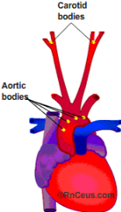
Types of receptors:
Osmoreceptors
In hypothalamus
Detect osmotic pressure (related to ion concentration), monitoring water homeostasis
Chemoreceptors
Different types of chemoreceptors
Stimulated by particular chemicals
In nose and mouth – smell and taste
In blood vessels (aorta and carotids): detect blood pH, O₂ and CO₂ concentration.
Baroreceptors
Detect Blood Pressure
In carotids and aortic arch
Learning Aim: List different sensors in the body, where they are located and what they sense.

Slide 17

Types of receptors:
Pain receptors (nociceptors)
In almost all organs
Many in skin and mucous membranes
None in brain
Stimulated by tissue damage, or risk of tissue damage, and carry signals to brain.
Learning Aim: List different sensors in the body, where they are located and what they sense.

Slide 18
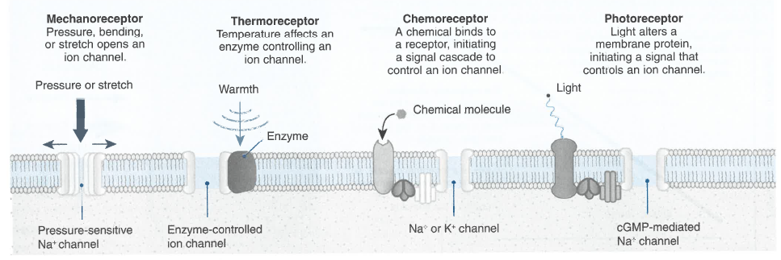
Some examples of how receptors work at a membrane level…

Slide 19
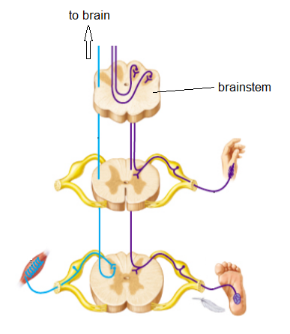
Sensory neurons
Stimulated by sense organs/receptors
Bundled into nerves
Some nerves contain only sensory fibres
Other (mixed) nerves contain some sensory fibres, but also motor fibres
Carry signals to spinal cord (spinal nerves) or base of brain (cranial nerves)
Sensory neurons enter via dorsal root of spinal cord
Cell bodies of sensory neurons are located in dorsal root ganglion
Spinal cord relays information to brain
Information provided about body’s current state and functions
Learning Aim: Describe the organisation of sensory neurons and their pathway into the spinal cord.

Slide 20
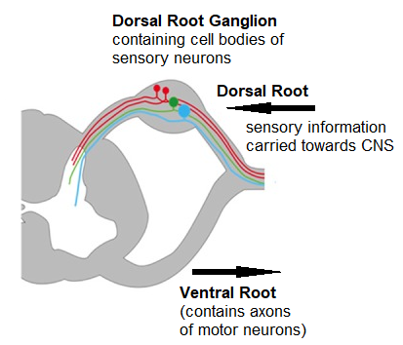
Sensory neurons
Learning Aim: Describe the organisation of sensory neurons and their pathway into the spinal cord.

